Slide 1


Built-in Functions
Functions and Wildcards in SQL Server
SoftUni Team
Technical Trainers
Software University
http://softuni.bg

Slide 2
Table of Contents
Function Overview
String Functions
Math Functions
Date Functions
Other Useful Functions
Wildcards

Slide 3
Questions
sli.do #CSharpDB

Slide 4

Functions in SQL Server
Overview

Slide 5
SQL Functions
Aggregate functions
Aggregate functions perform a calculation on a set of values and return a single value. They are allowed in the select list or the HAVING clause of a SELECT statement. You can use an aggregation in combination with the GROUP BY clause to calculate the aggregation on categories of rows.
Analytic functions
Analytic functions compute an aggregate value based on a group of rows. However, unlike aggregate functions, analytic functions can return multiple rows for each group. You can use analytic functions to compute moving averages, running totals, percentages, or top-N results within a group.

Slide 6

SQL Functions
Ranking functions
Ranking functions return a ranking value for each row in a partition. Depending on the function that is used, some rows might receive the same value as other rows.
Rowset functions
Rowset functions Return an object that can be used like table references in an SQL statement.
Scalar functions
Operate on a single value and then return a single value. Scalar functions can be used wherever an expression is valid.

Slide 7
SQL Functions
Function Collation
Functions that take a character string input and return a character string output use the collation of the input string for the output.
Functions that take non-character inputs and return a character string use the default collation of the current database for the output.
Functions that take multiple character string inputs and return a character string use the rules of collation precedence to set the collation of the output string. For more information, see Collation Precedence (Transact-SQL).

Slide 8

String Functions

Slide 9
String Functions
Concatenation – combines strings
CONCAT replaces NULL values with empty string
SELECT FirstName + ' ' + LastName
AS [Full Name]
FROM Employee
SELECT CONCAT(FirstName, ' ', LastName)
AS [Full Name]
FROM Employee

Slide 10
String Functions
Concatenation – combines strings
CONCAT_WS ( separator, argument1, argument2 [, argumentN]... )
CONCAT_WS ignores null values during concatenation, and does not add the separator between null values. Therefore, CONCAT_WS can cleanly handle concatenation of strings that might have "blank" values
SELECT CONCAT_WS(' ', FirstName, LastName)
AS [Full Name]
FROM Employee
SELECT CONCAT_WS(',','1 Microsoft Way', NULL, NULL, 'Redmond', 'WA', 98052) AS Address;

Slide 11
String Functions (2)
SUBSTRING – extracts a part of a string
Example: get short summary of an article
SUBSTRING(String, StartIndex, Length)
SUBSTRING('SoftUni', 5, 3)
Uni
SELECT ArticleId, Author, Content,
SUBSTRING(Content, 1, 200) + '...' AS Summary
FROM Articles

Slide 12
String Functions (3)
REPLACE – replaces a specific string with another
Example: censor the word blood from album names
REPLACE(String, Pattern, Replacement)
REPLACE('SoftUni', 'Soft', 'Hard')
HardUni
SELECT REPLACE(Title, 'blood', '*****')
AS Title
FROM Album

Slide 13
String Functions (4)
LTRIM & RTRIM – remove spaces from either side of string
LEN – counts the number of characters
DATALENGTH – gets the number of used bytes
LTRIM(String)
RTRIM(String)
LEN(String)
DATALENGTH(String)

Slide 14
String Functions (5)
LEFT & RIGHT – get characters from the beginning or the end of a string
Example: name shortened (first 3 letters)
LEFT(String, Count)
RIGHT(String, Count)
SELECT Id, Start,
LEFT(Name, 3) AS Shortened
FROM Games

Slide 15
Problem: Obfuscate CC Numbers
Our database contains credit card details for customers
Provide a summary without revealing the serial numbers
ID | FirstName | LastName | PaymentNumber
1 | Guy | Gilbert | 5645322227179083
2 | Kevin | Brown | 4417937746396076
… | … |  | …
ID | FirstName | LastName | PaymentNumber
1 | Guy | Gilbert | 564532**********
2 | Kevin | Brown | 441793**********
… | … |  | …

Slide 16
Solution : Obfuscate CC Numbers
We reveal the first 6 digits and obfuscate the rest
Bonus – create a View for the use of clients
SELECT CustomerID,
FirstName,
LastName,
LEFT(PaymentNumber, 6) + '**********'
FROM Customers
CREATE VIEW v_PublicPaymentInfo AS
…

Slide 17
String Functions (6)
LOWER & UPPER – change letter casing
REVERSE – reverses order of all characters in a string
REPLICATE – repeats a string
LOWER(String)
UPPER(String)
REVERSE(String)
REPLICATE(String, Count)

Slide 18
String Functions (7)
CHARINDEX – locates a specific pattern (substring) in a string
STUFF – inserts a substring at a specific position
Optional, begins at 1
CHARINDEX(Pattern, String, [StartIndex])
STUFF(String, StartIndex, Length, Substring)
Number of chars
to delete

Slide 19
String Functions (8)
FORMAT – returns a value formatted with the specified format and optional culture in SQL Server 2017. Use the FORMAT function for locale-aware formatting of date/time and number values as strings
The format argument must contain a valid .NET Framework format string, either as a standard format string (for example, "C" or "D"), or as a pattern of custom characters for dates and numeric values (for example, "MMMM DD, yyyy (dddd)")
FORMAT ( value, format [, culture ] )

Slide 20
String Functions (9)
TRANSLATE – returns the string provided as a first argument after some characters specified in the second argument are translated into a destination set of characters specified in the third argument
TRANSLATE ( inputString, characters, translations)
SELECT TRANSLATE('2*[3+4]/{7-2}', '[]{}', '()()’);
// 2*(3+4)/(7-2)

Slide 21

Math Functions
Arithmetic, PI, ABS, ROUND, etc.

Slide 22
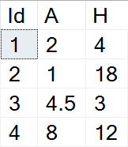
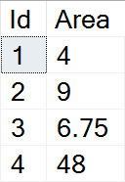

Math Functions
SQL Server supports basic arithmetic operations
Example: find the area of triangles by the given side and height
SELECT Id,
(A*H)/2 AS Area
FROM Triangles

Slide 23
Math Functions (2)
PI – gets the value of Pi as a float (15 –digit precision)
ABS – absolute value
SQRT – square root (the result will be float)
SQUARE – raise to power of two
SELECT PI() --3.14159265358979
ABS(Value)
SQRT(Value)
SQUARE(Value)

Slide 24
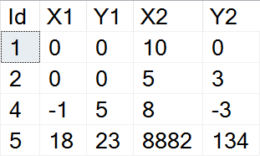
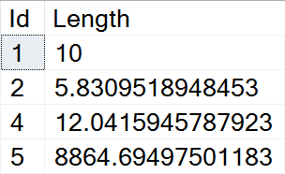
Example: Line Length
Find the length of a line by given coordinates of the end points
SELECT Id,
SQRT(SQUARE(X1-X2) + SQUARE(Y1-Y2))
AS Length
FROM Lines

Slide 25
Math Functions (3)
POWER – raises value to the desired exponent
ROUND – obtains the desired precision
Negative precision rounds characters before the decimal point
FLOOR & CEILING – return the nearest integer
POWER(Value, Exponent)
ROUND(Value, Precision)
FLOOR(Value)
CEILING(Value)

Slide 26
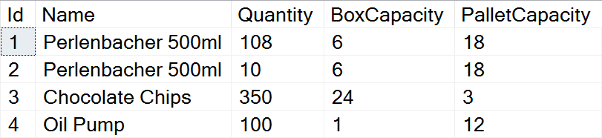
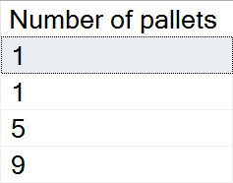
Problem: Pallets
Calculate the required number of pallets to ship each item
BoxCapacity specifies how many items can fit in one box
PalletCapacity specifies how many boxes can fit in a pallet

Slide 27
Solution: Pallets
Since we can't use half a box or half a pallet, we need to round up to the nearest integer value
SELECT
CEILING(
CEILING(
CAST(Quantity AS float) /
BoxCapacity) / PalletCapacity)
AS [Number of pallets]
FROM Products

Slide 28
Math Functions (4)
SIGN – returns 1, -1 or 0, depending on the value of the sign
RAND – gets a random float value in the range [0, 1]
If Seed is not specified, it will be assigned randomly
SIGN(Value)
RAND()
RAND(Seed)

Slide 29

Date Functions
GETDATE, DATEDIFF, DATEPART, etc.

Slide 30
Date Functions
DATEPART – extract a segment from a date as an integer
Part can be any part and format of date or time
For a full list, take a look at the official documentation
DATEPART(Part, Date)
year, yyyy, yy
YEAR(Date)
month, mm, m
MONTH(Date)
day, dd, d
DAY(Date)

Slide 31
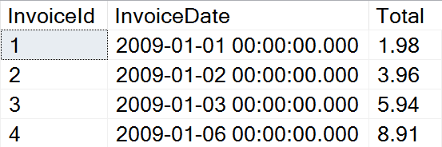
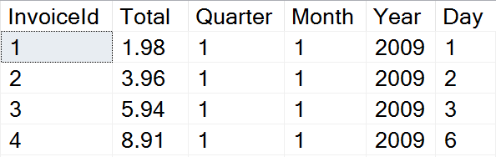
Problem: Quarterly Report
Prepare sales data for aggregation by displaying yearly quarter, month, year and day of sale

Slide 32
Solution: Quarterly Report
Use DATEPART to get the relevant parts of the date
This statement might be useful as a View
SELECT InvoiceId, Total,
DATEPART(QUARTER, InvoiceDate) AS Quarter,
DATEPART(MONTH, InvoiceDate) AS Month,
DATEPART(YEAR, InvoiceDate) AS Year,
DATEPART(DAY, InvoiceDate) AS Day
FROM Invoice

Slide 33
Date Functions (2)
DATEDIFF – finds the difference between two dates
Part can be any part and format of date or time
Example: Show employee experience
DATEDIFF(Part, FirstDate, SecondDate)
SELECT ID, FirstName, LastName,
DATEDIFF(YEAR, HireDate, '2017/01/25')
AS [Years In Service]
FROM Employees

Slide 34
Date Functions (3)
DATENAME – gets a string representation of a date's part
DATEADD – performs date arithmetic
Part can be any part and format of date or time
GETDATE – obtains the current date and time
DATENAME(Part, Date)
SELECT DATENAME(weekday, '2017/01/27')
DATEADD(Part, Number, Date)
SELECT GETDATE()

Slide 35
Date Functions (4)
EOMONTH – this function returns the last day of the month containing a specified date, with an optional offset.
If the month_to_add argument has a value, then EOMONTH adds the specified number of months to start_date, and then returns the last day of the month for the resulting date
EOMONTH ( start_date [, month_to_add ] )
SELECT EOMONTH('2017/01/27’)
// 2017-01-31

Slide 36


Other Functions
CAST, CONVERT, OFFSET, FETCH

Slide 37
Other Functions
CAST & CONVERT – conversion between data types
ISNULL – swaps NULL values with a specified default value
Example: Display “Not Finished” for projects with no EndDate
CAST(Data AS NewType)
CONVERT(NewType, Data)
ISNULL(Data, DefaultValue)
SELECT ProjectID, Name,
ISNULL(CAST(EndDate AS varchar), 'Not Finished')
FROM Projects

Slide 38
Other Functions (2)
COALESCE – evaluates the arguments in order and returns the current value of the first expression that initially does not evaluate to NULL
SELECT COALESCE(NULL, NULL, 'third_value', 'fourth_value');
// third_value

Slide 39
Other Functions(3)
OFFSET & FETCH – get only specific rows from the result set
Used in combination with ORDER BY for pagination
SELECT ID, FirstName, LastName
FROM Employees
ORDER BY ID
OFFSET 10 ROWS
FETCH NEXT 5 ROWS ONLY
Rows to skip
Rows to include

Slide 40
Other Functions(4)
ROW_NUMBER – always generate unique values without any gaps, even if there are ties
RANK – can have gaps in its sequence and when values are the same, they get the same rank
DENSE_RANK – returns the same rank for ties, but it doesn’t have any gaps in the sequence

Slide 41

Wildcards
Selecting results by partial match

Slide 42
Using WHERE … LIKE
Wildcards are used with WHERE for partial filtration
Similar to Regular Expressions, but less capable
Example: Find all employees who's first name starts with "Ro"
SELECT ID, FirstName, LastName
FROM Employees
WHERE FirstName LIKE 'Ro%'
Wildcard symbol

Slide 43
Wildcard Characters
Supported characters include:
ESCAPE – specify a prefix to treat special characters as normal
% -- any string, including zero-length
_ -- any single character
[…] -- any character within range
[^…] -- any character not in the range
SELECT ID, Name
FROM Tracks
WHERE Name LIKE '%max!%' ESCAPE '!'

Slide 44

Summary
…
…
…
Various built-in functions
String functions - CONCAT, LEFT/RIGHT, REPLACE, etc.
Math functions - PI, ABS, POWER, ROUND, etc.
Date functions - DATEPART, DATEDIFF, GETDATE, etc.
Using Wildcards, we can obtain results by partial string matches

Slide 46













SoftUni Diamond Partners

Slide 47




SoftUni Organizational Partners

Slide 48

License
This course (slides, examples, demos, videos, homework, etc.) is licensed under the "Creative Commons Attribution-NonCommercial-ShareAlike 4.0 International" license

Slide 49




Trainings @ Software University (SoftUni)
Software University – High-Quality Education and Employment Opportunities
softuni.bg
Software University Foundation
http://softuni.foundation/
Software University @ Facebook
facebook.com/SoftwareUniversity
Software University Forums
forum.softuni.bg

